Slide 1








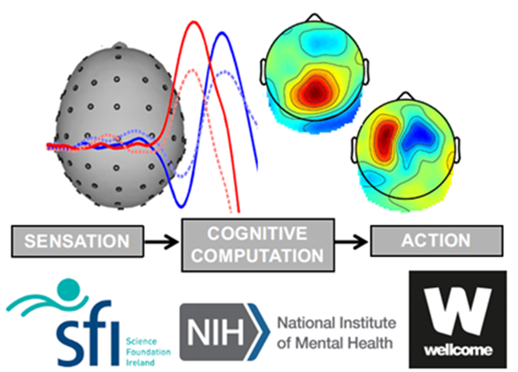


The influence of response effector on decision adaptations
11/Nov/2024
RSP meeting- Nov 2024 (Jan entry)
School of Electrical and Electronic Engineering
Supervisors :
Prof. Elaine Corbett
Prof. Simon Kelly
RSP members:
Prof. Stephen Redmond
Prof. Emer Doheny
University College Dublin,
Biomedical Engineering, Dublin, Ireland,
liang.tong2@ucdconnect.ie
Liang Tong
17208987

Slide 2
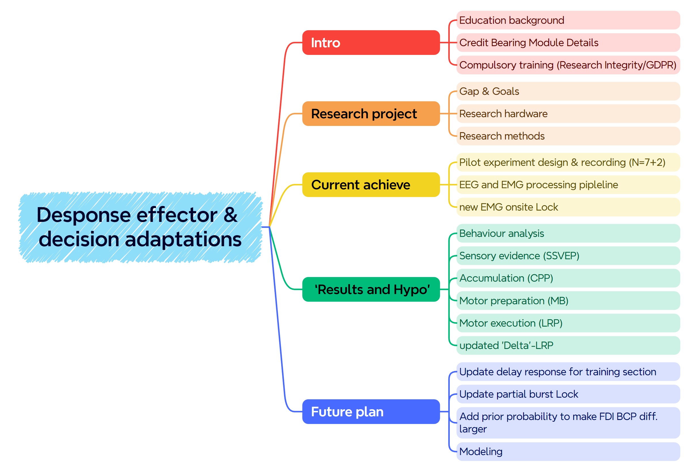

Slide 3

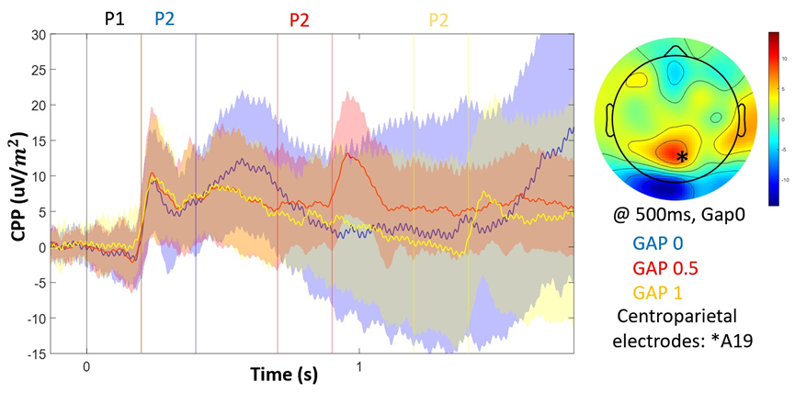
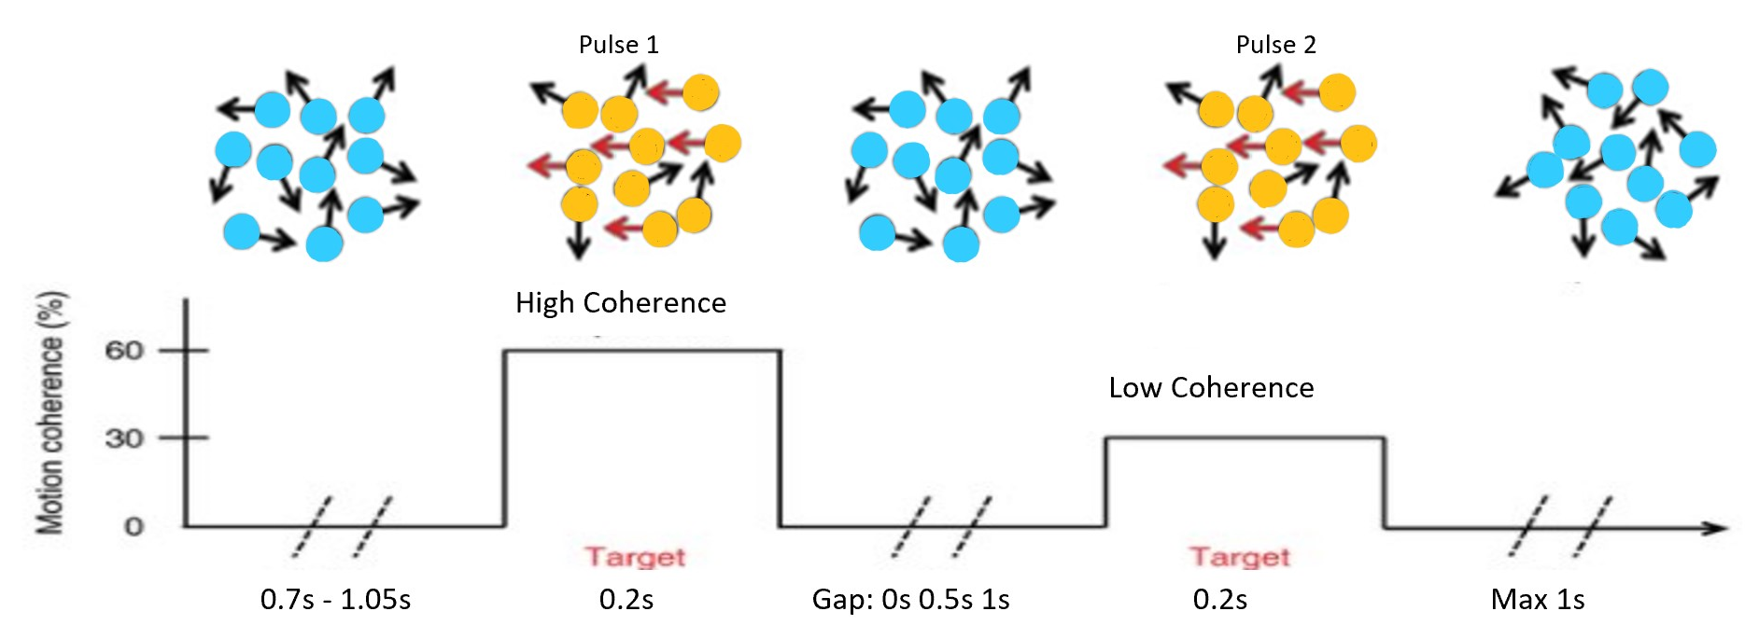
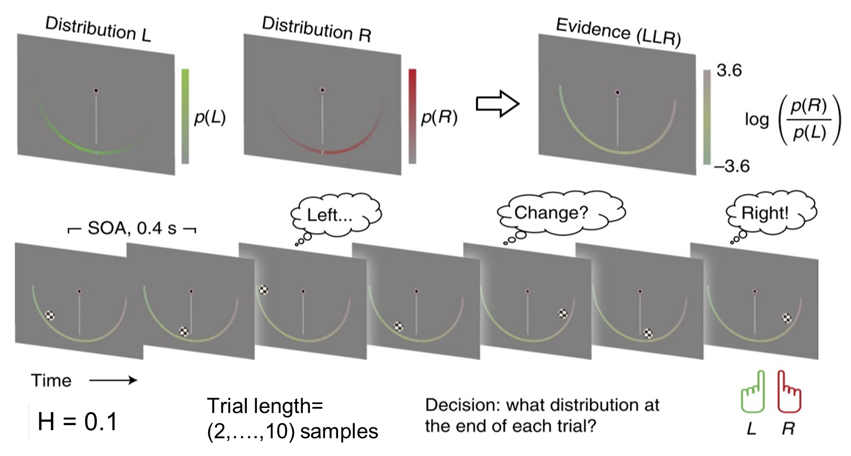
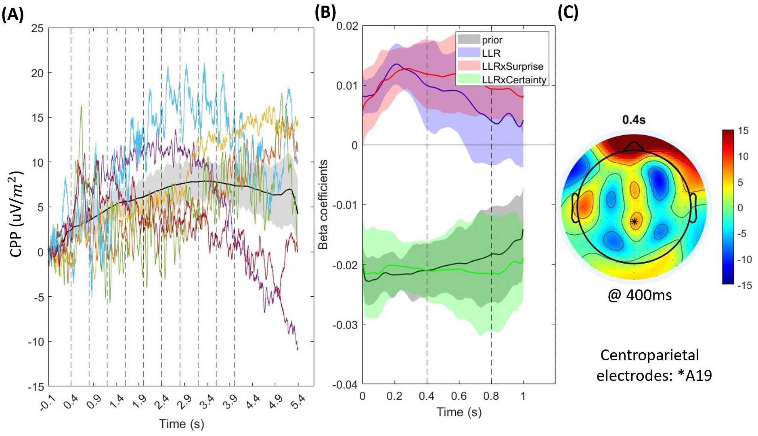
Backgrounds
Notes:
由于是第一次RSP,这是我的教育背景
一张图介绍我之前的每个项目
主要学习了了两个实验，对于稳定和不稳定环境，并学了CPP对于不同环境的不同。比如perfect (lossless) accumulation 在稳定环境和leaky accumulation在volatile environment

Slide 4
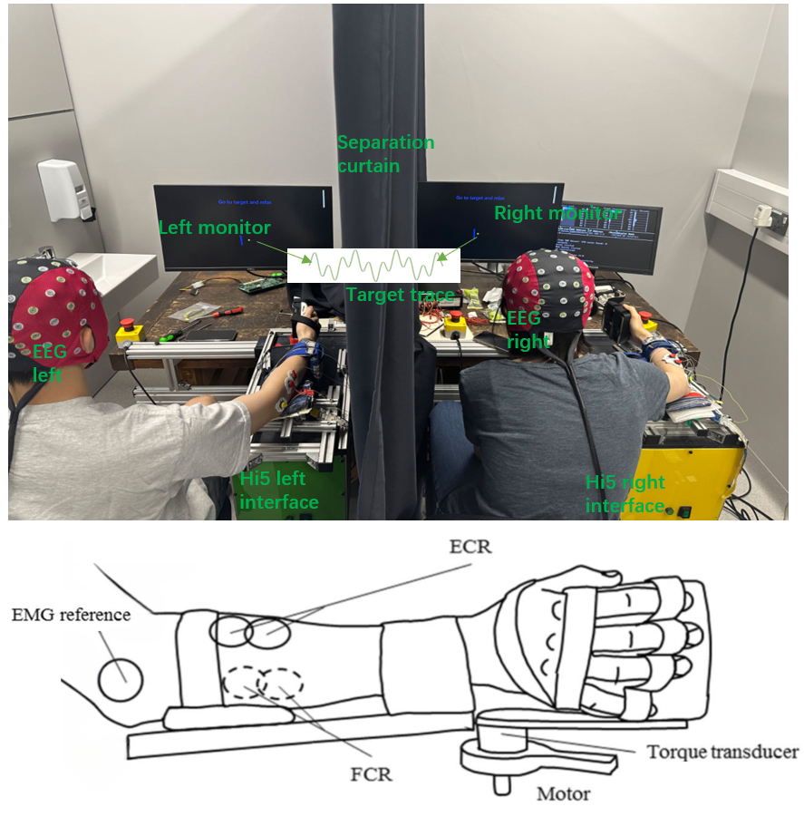
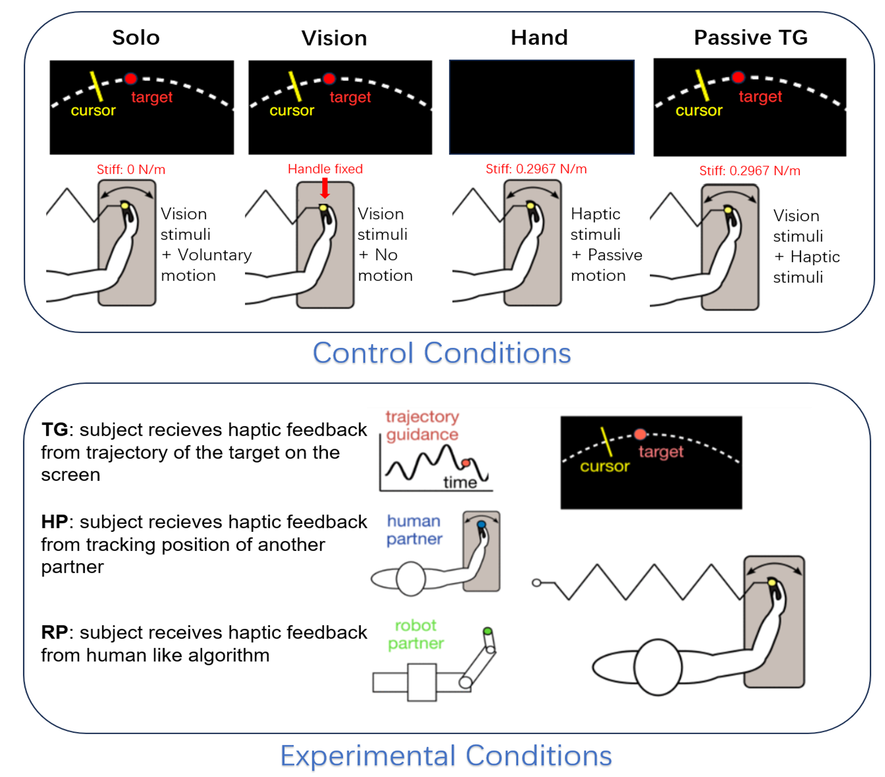
Backgrounds
A
B
Notes:
去年做的用EEG hyper-scanning 做haptic communication/social interaction的研究，同时对EMG，力矩，error rate进行分析
主要用了Fuzzy entropy和 IBS对 不同实验条件和不同脑区的分类。证明了类人算法的机器人也可与真人产生社交互动。
现阶段下一个学生在继续做leader/follower的研究
如有时间可以讨论一些通用的方法，我有一些backup slide 对于之前研究的方法
%%%%%%%%%%%%%%%%%%%%%%%
比如IBS 变成inter-trial

Slide 5
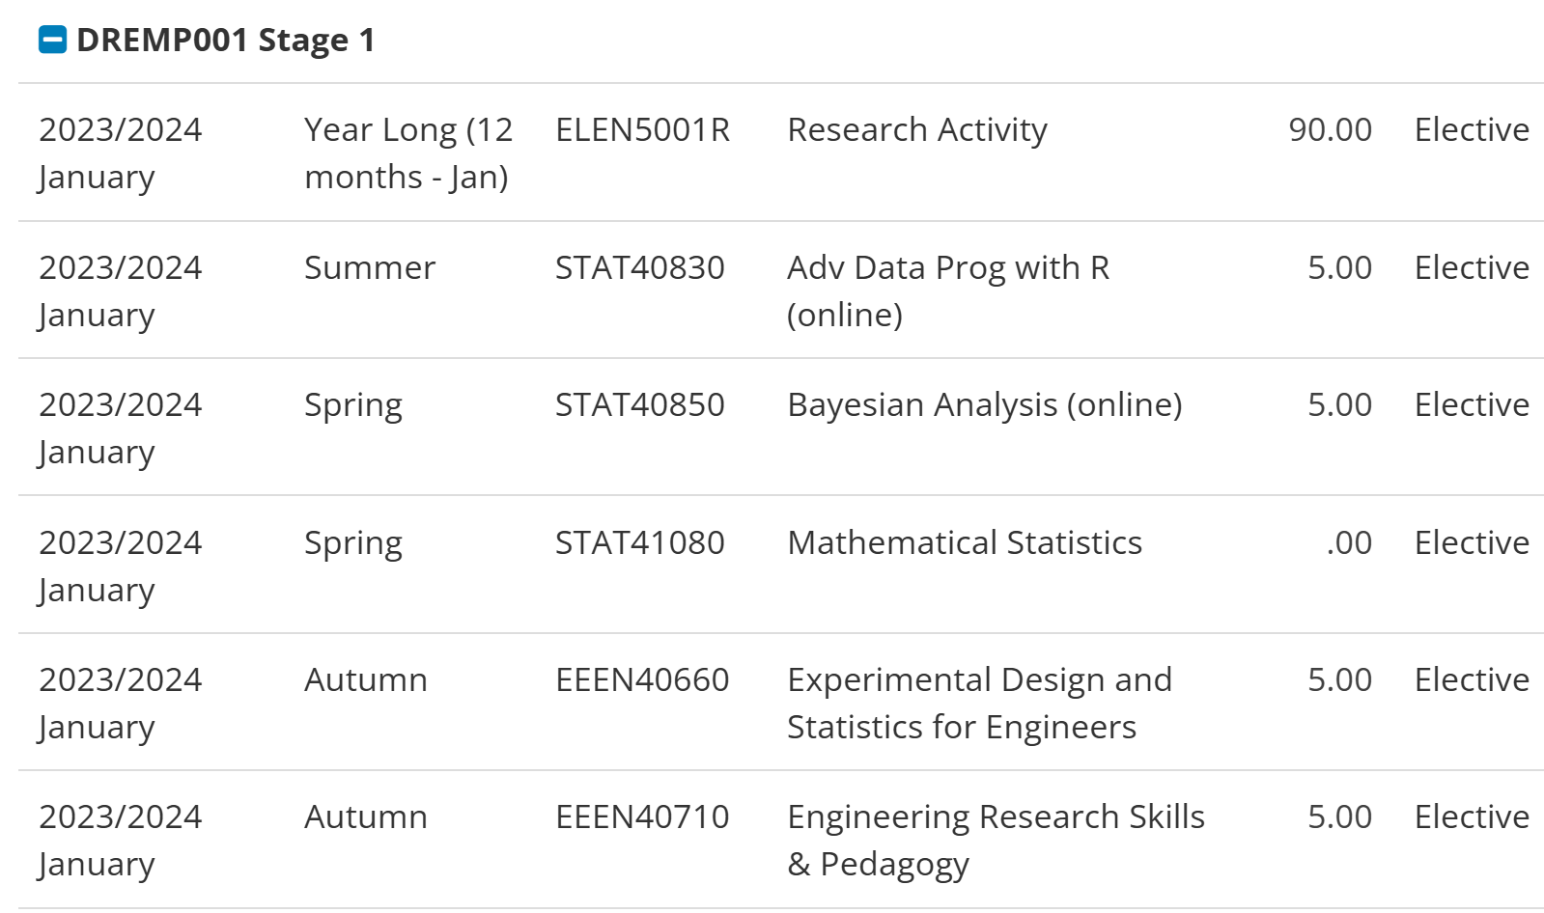
Credit Bearing Module Details (20/30 credit)
Notes:
我计划一个学期上5学分来平衡我的研究与新技能学习。我已经完成了Advance R语言的作图与统计与展示以及基于R stan的贝叶斯分析。这个学期主要集中在复习统计学与python语言。剩下的10学分我计划学习还有一节必修课Optimisation Techniques for Engineers 和python

Slide 6
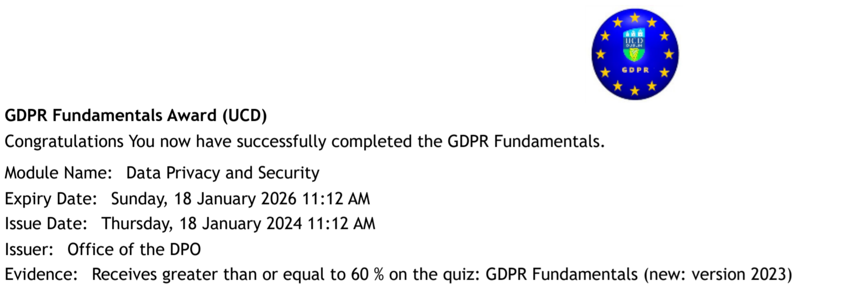


Compulsory training completed

Slide 7
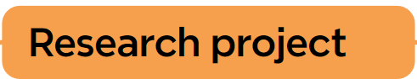
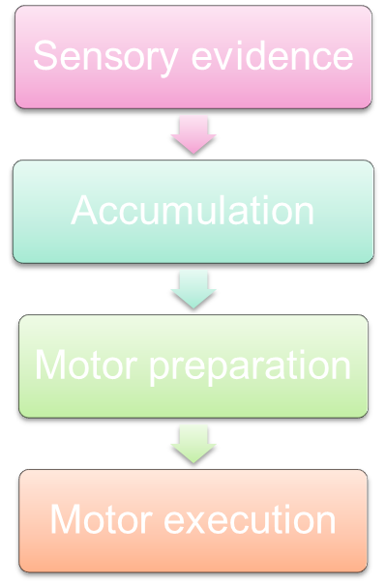
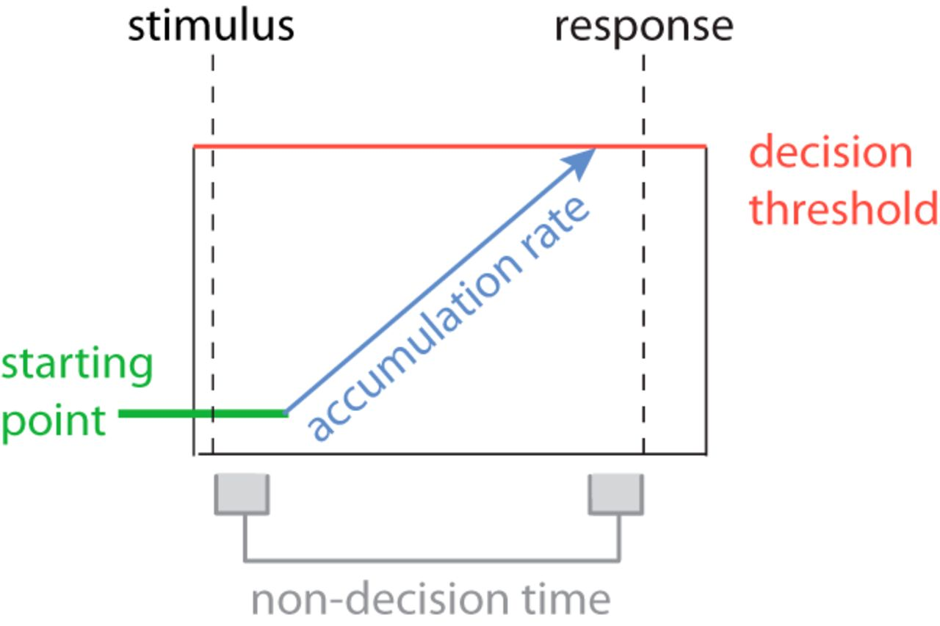
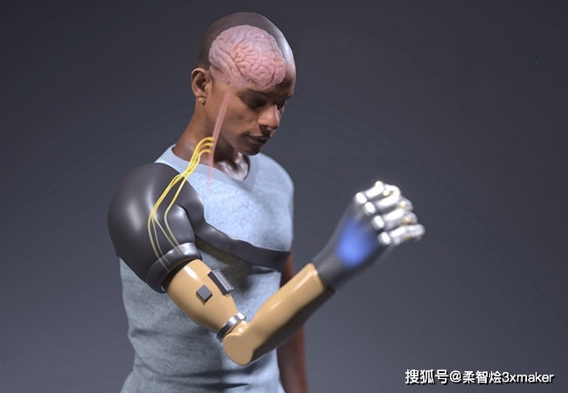
Gap
SSM can’t distinguish three decision process
Motor process is simplified as delay
Explain motor control better
Goals
1. Whether Decision adaptation between sensory to motor area is muscle dependence (FDI vs BCP)?
2. The precise timing of decision commitment
Notes:
1.SSM 不能区分三大进程sensory，cognitive， motor
2.大多数决策用简单动作（按钮或鼠标），造成两个问题。第一把motor process 简化为delay，第二集中在远端肌肉，但假肢用近端比较多，且手与脑区的链接比手臂多且复杂
因为大多数DM操作的是sensory和cognitive 层面，有了EMG界面的帮助可以操作motor 层面, 且可以确定决策commitment
3.存在自上而下的连续流，从sensory 不停流向neuromuscular
4.运动系统的实时状态也可影响sensory area
6.需要解释neuro-musclar中的motor control， 在老的SSM里归类为前两个进程如perceptual/cognitive
This project aims to use a myoelectric interface to compare decision-making processes between finger and bicep movements under different conditions. The goal is to understand if our ability to adapt decisions in real-time depends on the muscle being used. By analyzing brain signals and behavior, we can learn if there are differences in how evidence is processed and if this affects motor control.

Slide 8
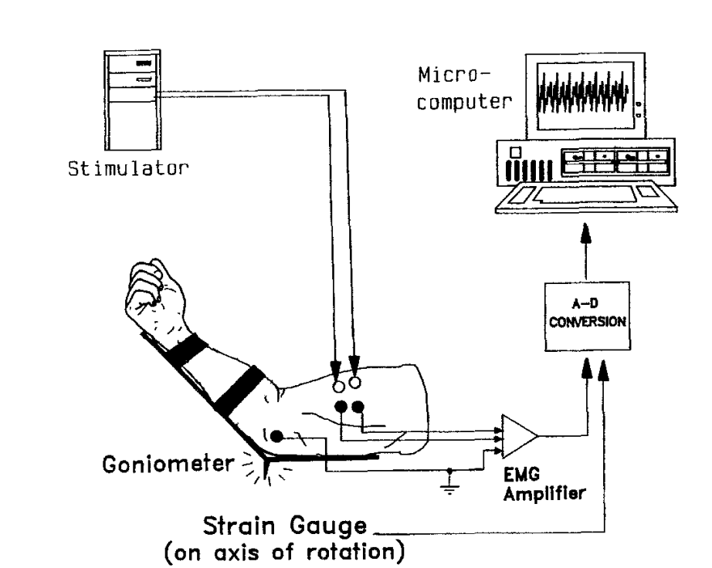
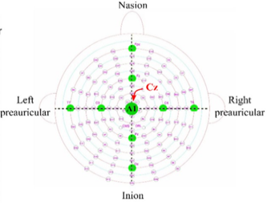
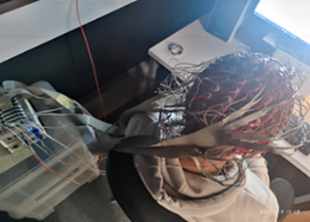
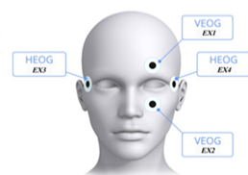
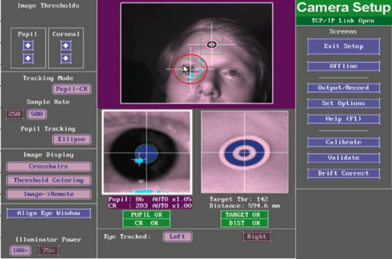
Research hardware
Fig.4 EMG on biceps (left); EEG cap (right)
EEG – 512Hz 128 channel 10-20 layout Biosimi
EMG – 2000Hz 4 channel Delsys Trigno
isometric contractions
keep the angle of the elbow joint at 115°
Fig.5 External EOG channels location (left); Eye-link system interface(right)
Notes:
常规的EEG设置，这个阶段的实验不会用到Eye-link,但后续可能加上
不同的是EMG的设置，在FDI和biceps个放置左右两个感应器，让肌肉做isometric contraction,且手臂的夹角需保持115度

Slide 9
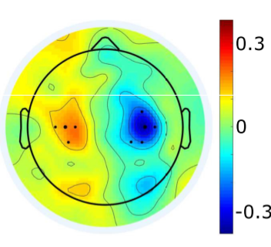
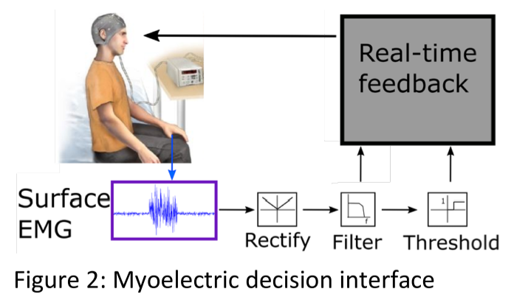
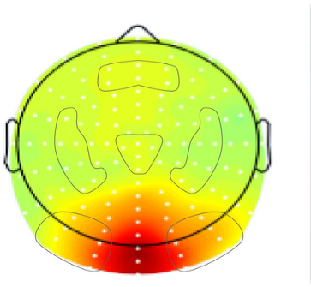
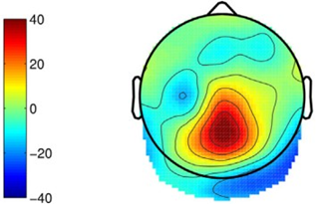

Research methods
Closed-loop muscle-computer interface
Stimuli design (3 key levels)
SSVEP at 21.25Hz
Smooth transfer to Evidence onset (clear CPP)
Motor preparation signals (14-30Hz)
Notes:
这是一个muscle computer的闭环控制界面，反馈由精确控制的肌肉激活提供（维持在某一水平50ms），关于决策形成的EEG特征同步记录
需要设计刺激能从EEG中追踪决策过程的演变 （三大level, sensory，cognitive， motor）
%%%%%%%%%%%%%%%%%%%%%%%%%%%%%%%%%%%%%%%%%%%%%%%%%
21.5hz的SSVEP可以反应evidence强度
Smooth transfer to the stimuli onset 可以使CPP更清晰，CPP是effector independence的，意味着两个肌肉相同
motor preparation signals 是effector-selective 的 有build-to-threshold activity 导致响应，可以比较不同效应器的不同
a closed-loop muscle computer interface for decision making in which a carefully controlled muscle activation triggers a response, while EEG signatures of decision formation are simultaneously measured.
The stimuli should be designed so that the evolution of the decision process can be traced in EEG measurements at 3 key levels in the brain.
1) The sensory evidence will be modulated at specific frequencies designed to produce a steady-state visual evoked potential (SSVEP) that represents the strength of
the sensory evidence encoding30.
2) Smooth transitions in the stimulus display will minimise visual evoked potentials due to sudden onsets, providing a clear view of the effectorindependent signature of evidence accumulation known as the centro-parietal positivity (CPP)40.
3) We will measure effector-selective motor preparation signals in the Beta band (14-30 Hz) which exhibit build-to-threshold activity leading up to a response

Slide 10

Current achieve
Finished recording and analysis for Polit Experiment 1 (N=7+2)
Auto EEG processing pipeline – test and ready
EMG processing pipeline:
linear envelope (ENV) (RMS method)
Fuzzy Entropy (Z-score to balance noise )
EMG valid check manual pipeline (also for count partial burst)
New EMG onsite Lock in addition to SL,RL
LMM model for behaviour analysis
‘Delta’ – LRP

Slide 11
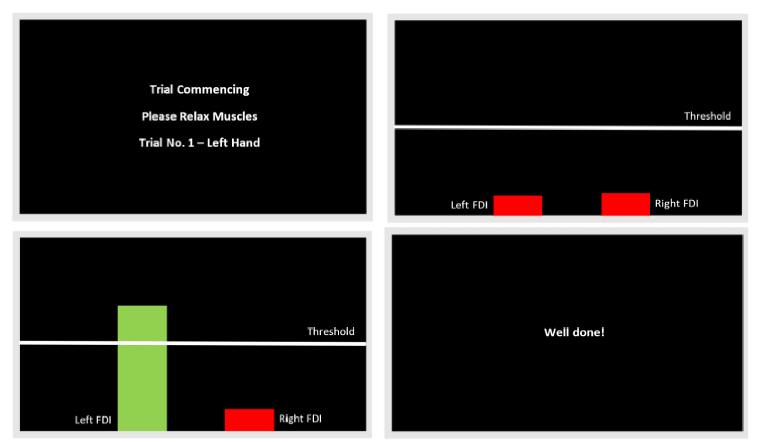

Pilot Experiment (N=7+2)
Training section (real-time feedback)
10 min EMG calibration
15 min for force control training (20%)
15 min for contrast discrimination task learning
Notes:
特定阈值的肌肉激活作为反应，且将会提供施加力的实时反馈，频幕上显示进度条
参与者将会学习如何控制他们的FDI肌肉与BCP肌肉
1个力 (大力有维持的反应feedback loop，小力直接击穿) 需要测试出用大还是用小

Slide 12
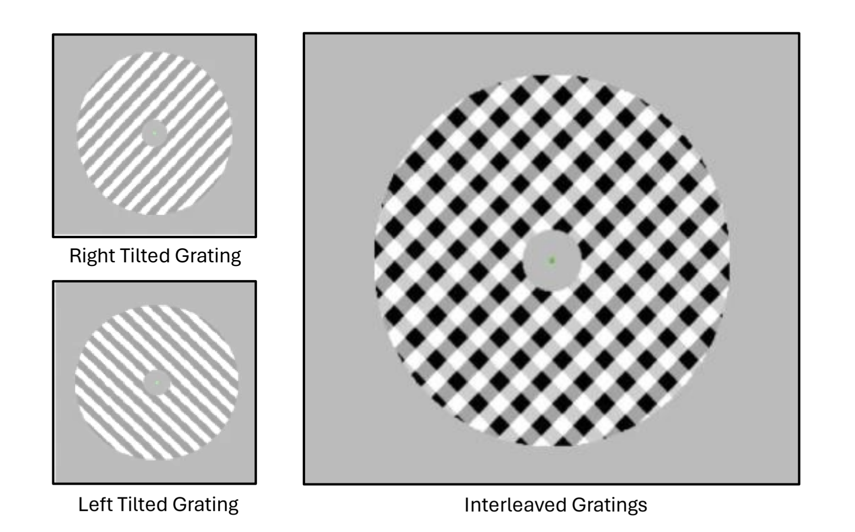
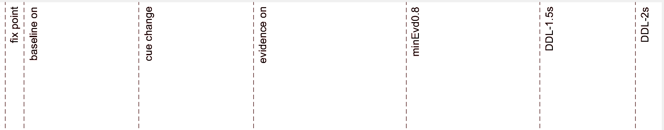

2 Response effector – FDI and Biceps
2 contrast level – easy (0.14) and hard (0.07)
1 force level - 20% MVA
1.5s DDL - speed pressure
128*8s trials *8 blocks =85 min
256 trials* 4 conditions
EVon
0.8s – 2s
RT
0.2s – 1.5s
0.2s
EVoff
0.1s
0.6s
0.6s
0.8s
0.7s
0.5s
Notes:
contrast discrimination task 作为polit ；
两个难度two difficulty levels， 有15分钟训练时间从0.4降到0.1，准确率大于60%即可开始实验
基线为黄点，变绿后0.6秒开始Evon， EV哦呢至少持续0.8秒，最长2秒。 RT有效时间为0.2-1.5s. 且在RT后有0.2秒delayEv消失.
注意1.5S 的DDL可能导致强烈的 speed pressure

Slide 13

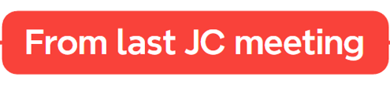
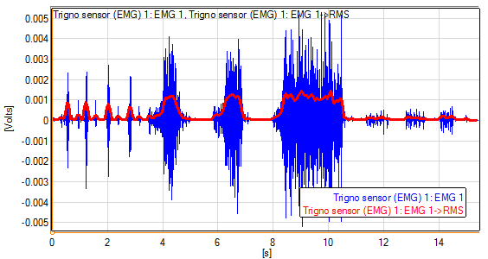
Notes:
Method 1: But not sensitive to capture small signal + noise. (which is important in DTDM model!)
Starting time not accurate
the reason of using Fuzzy entropy: - partial burst + EOL

Slide 14
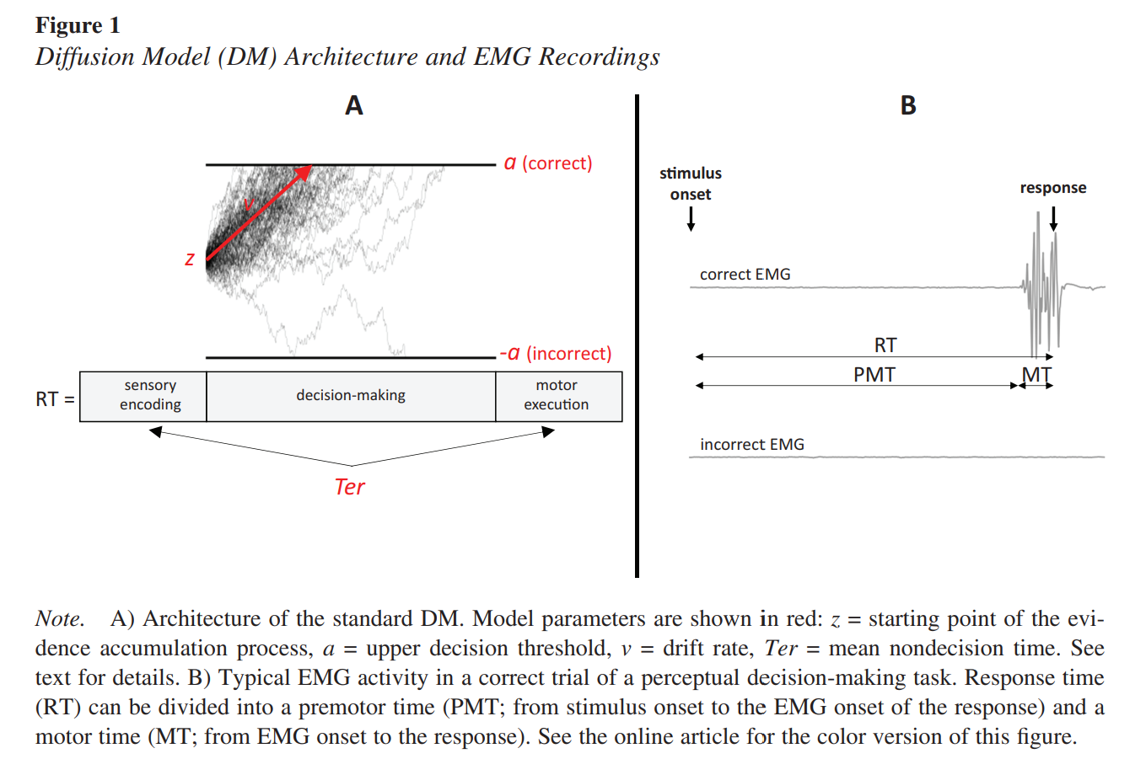
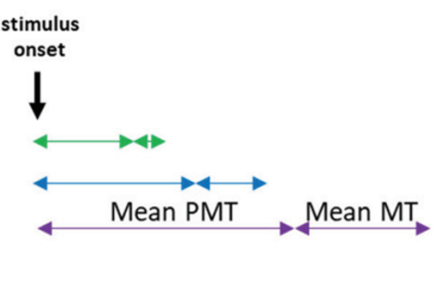
RL
EOL
SL
nondecision time 300-400ms
sensory delays (220ms)
motor delays (80ms)
EOL
EOL
When coherence ⬇
PMT & MT monotonically ⬇
Drift rate ⬇
Partial bursts number ⬆
First partial burst time ⬆
Why EOL？- focus on PMT and MT
-precise decision commitment time
Notes:
这是设置最小反应时间的原因，
1.SSM 不能区分三大进程sensory，cognitive， motor
2.大多数决策用简单动作（按钮或鼠标），造成两个问题。第一把motor process 简化为delay，第二集中在远端肌肉，但假肢用近端比较多，且手与脑区的链接比手臂多且复杂
因为大多数DM操作的是sensory和cognitive 层面，有了EMG界面的帮助可以操作motor 层面, 且可以确定决策commitment
EOL可以把motor delay分离开来，以研究不同肌肉在不同阶段的不同

Slide 15
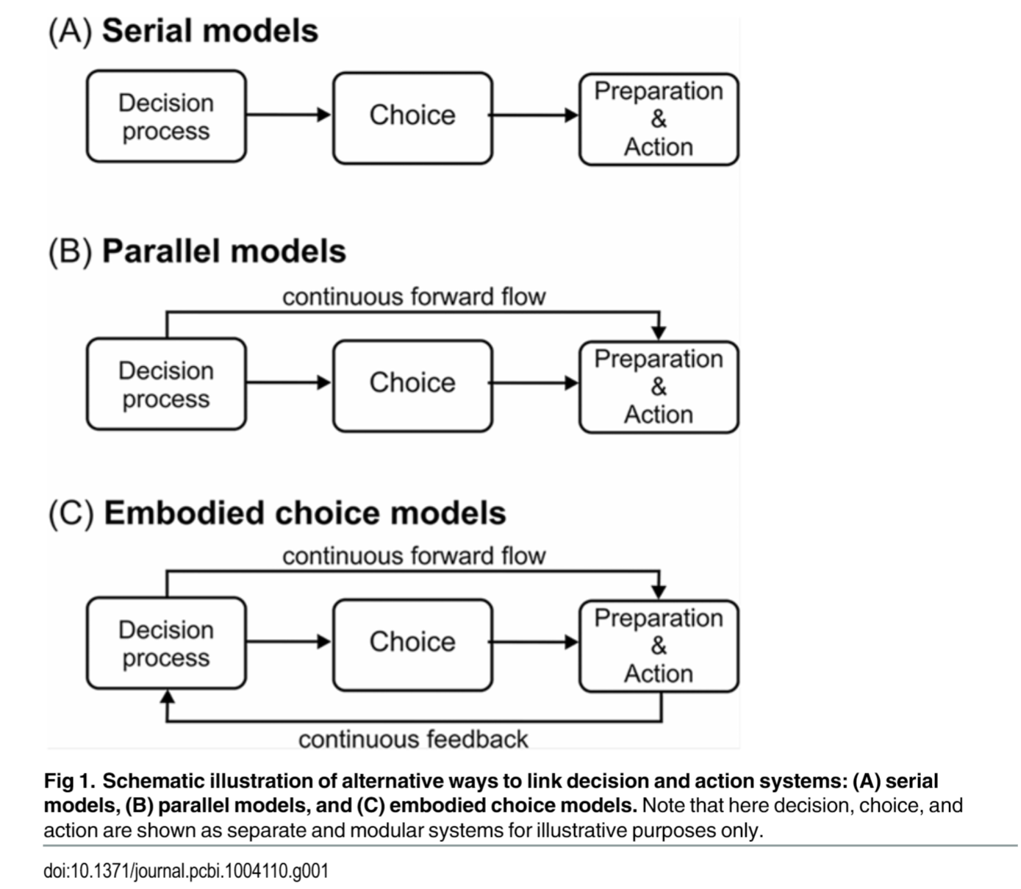
Decision making model type

Slide 16


Sensory evidence
Motor preparation
Accumulation
Motor execution
Amplitude: BCP=FDI
Time: BCP=FDI
Current ‘results and Hypo’
Amplitude: BCP>FDI
Time: BCP<FDI
BCP is more ‘Serial’ model
FDI have more ‘continues forward flow+ feedback loop’
BCP MT faster than FDI (Behaviour analysis)
No partial EMG burst in biceps (EMG analysis)
Same sensory input (SSVEP)
More medial areas of the motor cortex for BCP (scalp plot, LRP)
BCP PMT & MT monotonically decrease (CPP; MB)
Different participant different psychology kernel (LMM)
Between block there’s learning activity (LMM) – delayed feedback
* easy to accumulate
Amplitude: BCP<FDI
Time: BCP>FDI
* less connection
Amplitude: BCP>FDI
Time: BCP<FDI
* easy to accumulate
Notes:
主要是为了证明Decision adaptation between sensory to motor area is muscle dependence
以下是各个阶段发现的不同，右边是对EEG部分的总结。总的假设是由于BCP缺少feedback loop以及continus flow, 它在CPP更容易积累,在LRP更容易触发（fast-twitch）
但是在Motor preparation, 由于缺少与脑部的链接（BCP更难控制）
这也在行为层面被解释，通过比较RT,MT和EOL与CW,HL FDIBCP, LR的关系// 不同block和不同sub
这里主要比较HL，与FDIBCP

Slide 17
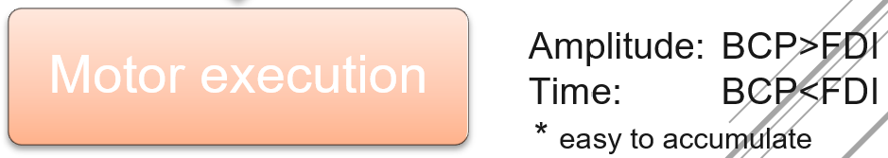

MT analysis
=RT- EMG onsite
p-value: 1.8912e-100
Confidence Interval: 0.036577 to 0.04378
BCP Motor time 36ms-43ms faster than FDI
Diff. shape means different DM strategy?
FDI 100ms faster; BCP 60ms faster (use for EOL update)
Notes:
这个结果是由算法加目视检查的得出的
与文献的时间符合，FDI更多outliear， BCP更集中

Slide 18
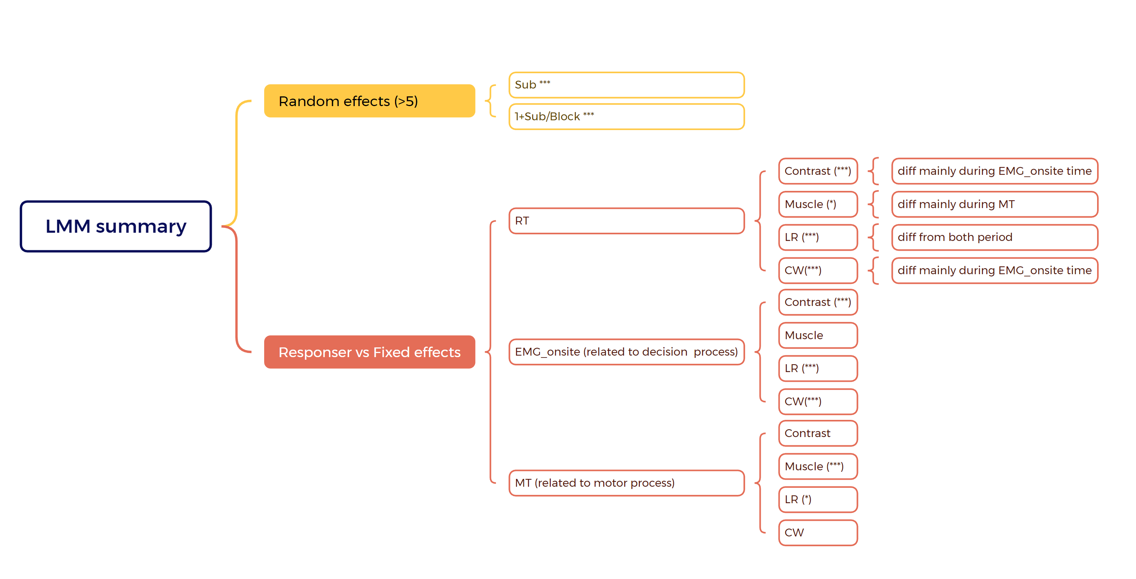
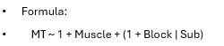

Notes:
这是LMM模型，比较6个人/8个block间，四种对照组的区别。与三种MT的关系
以下是两个模型公式的例子。。。
仅仅从RT看都有区别，但没法比较区别来自哪
从简单开始，CW只影响EMGonsite time， 因为主要区别在Decision period

Slide 19
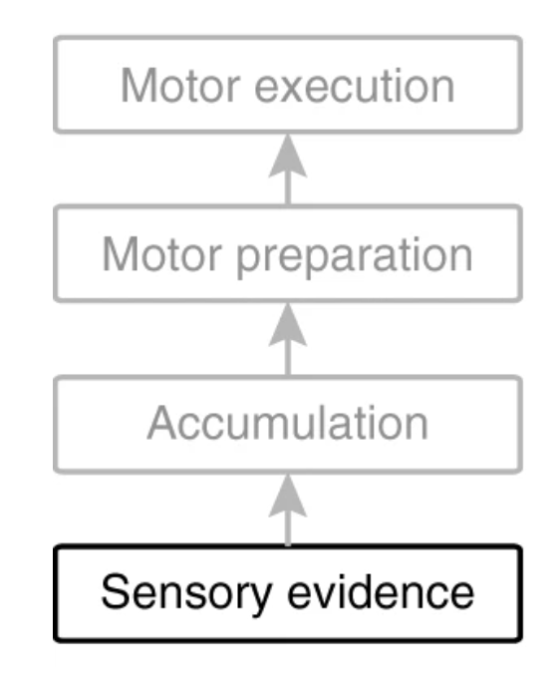
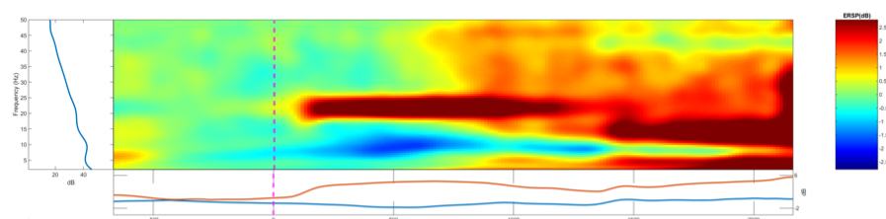
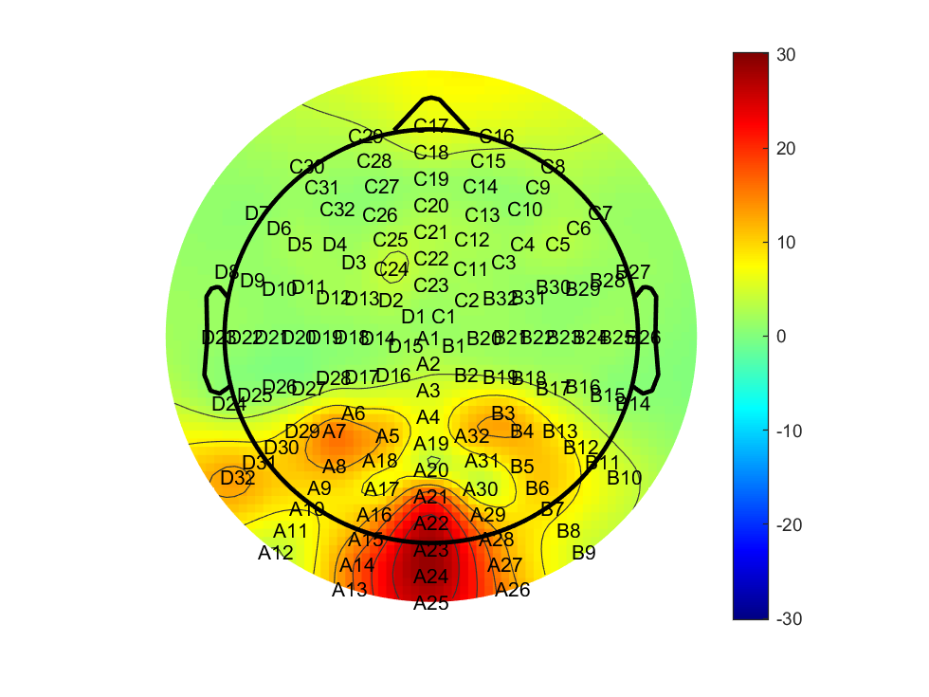

SSVEP (21.5Hz) - A23
bright first and dim first are opposite phase
Notes:
首先在evon后2.15hz附近观察到红条
高低有区别，起始有区别
且位置正确稳定
证明在时间分类上没有问题

Slide 20
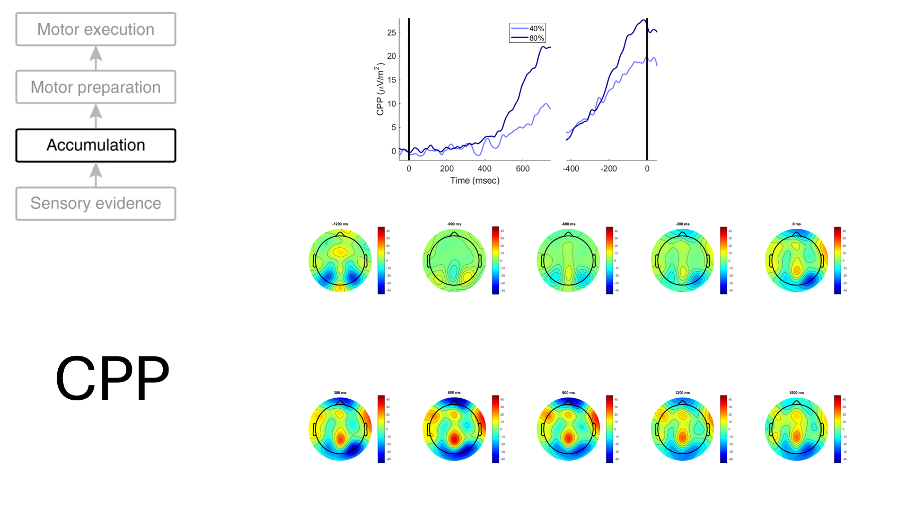
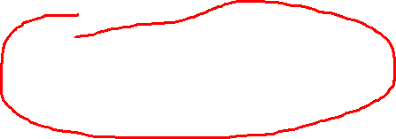
Notes:
这是我的cpp图与文章里的例子。期待遇到斜率不同与积累量不同

Slide 21

Notes:
这是HL的例子，不展开
Cue后300开始积累， ev后300出现斜率差异
可能是由于速度压力或者是实验者把cue当成evon导致的
或者由于speed pressure导致的

Slide 22
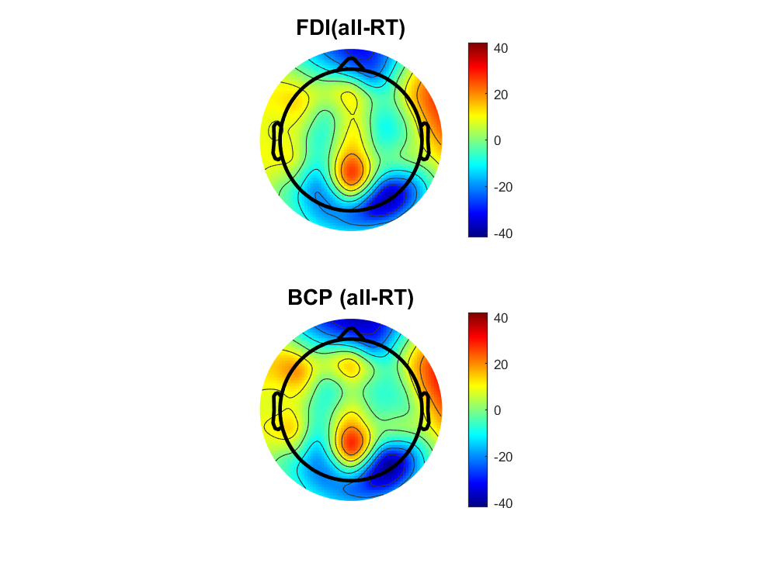
Notes:
这里把RT分为三类，快中慢
FDI三种时间peak相同，斜率不同
BCP三种时间Peak不同。斜率M and S比较晚出现斜率不同 （三种RT 对BCP影响可能较大）

Slide 23
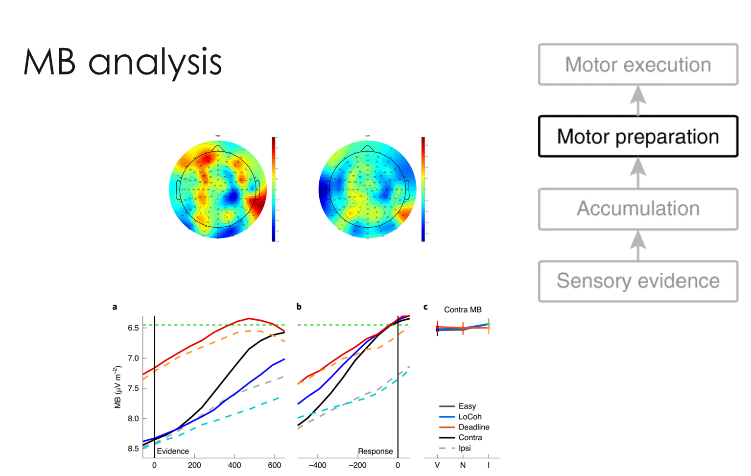

Notes:
上面是我的脑图，下面是例子
注意我的ddl是1.5秒且对于H变得更简单，对于L变得更难。
所以出现了DDL线，红线。但斜率变化存在且明显

Slide 24
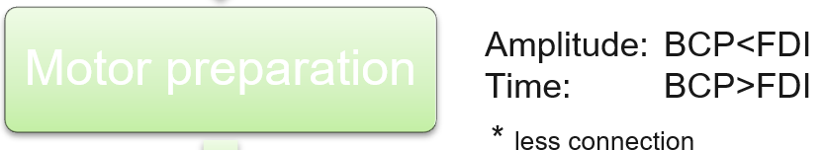
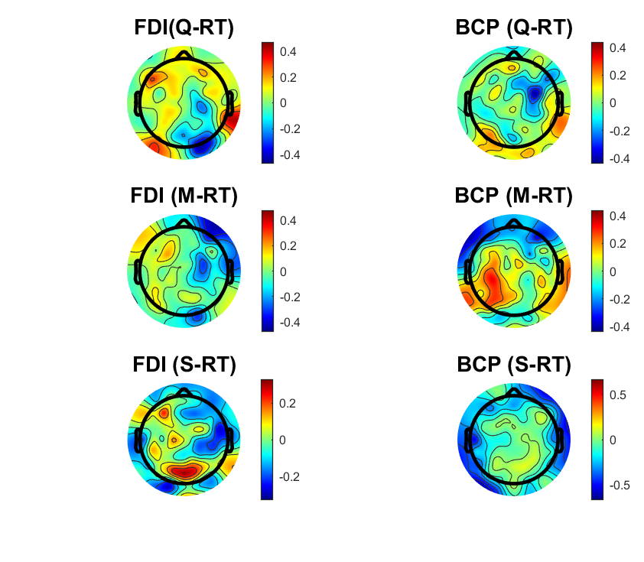
Notes:
暗示这里因为左右手的prior造成cue on 后时间差异， 红色为prior对了，绿色为prior错了导致慢
FDI 从cue开始不同，且斜率不同，峰值不同
BCP斜率相似，峰值相同，更像线性模型向后平移触发

Slide 25
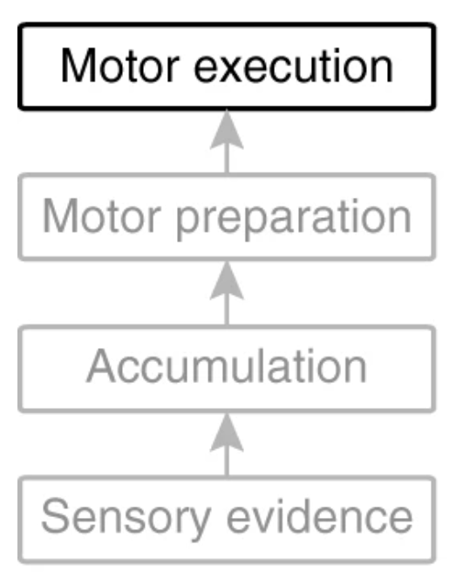
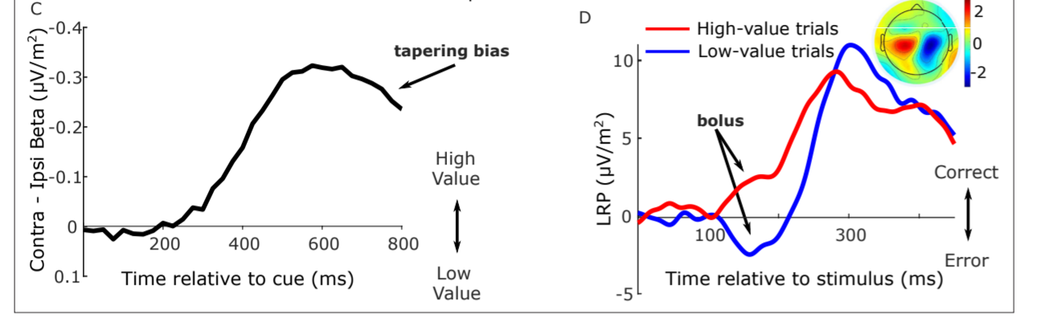
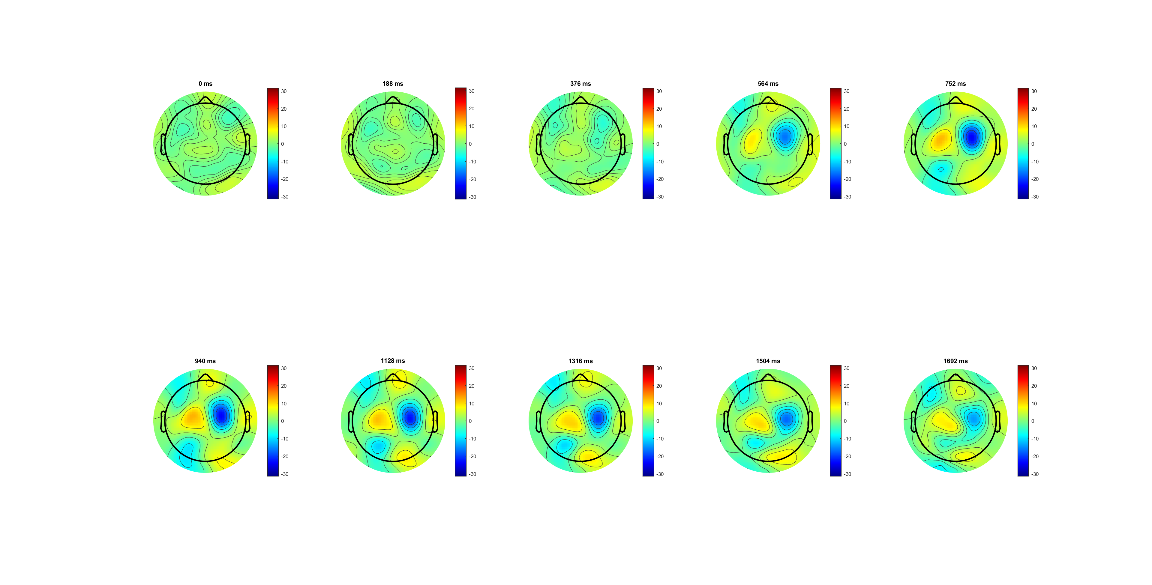
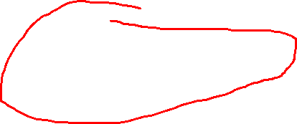
LRP analysis

Slide 26
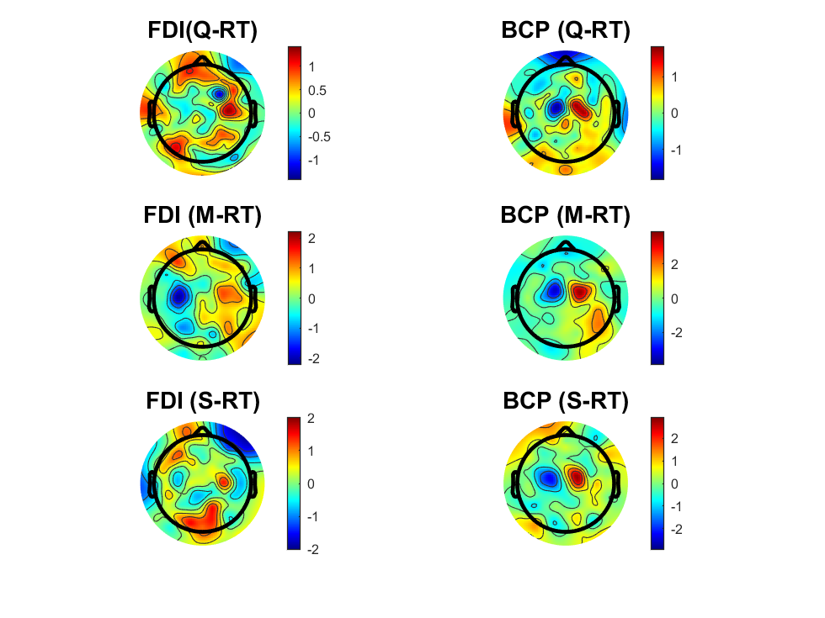
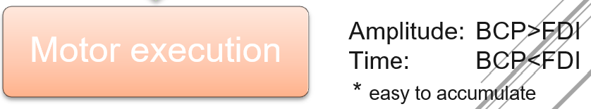
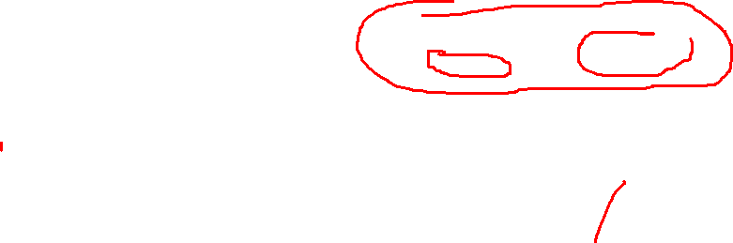
Notes:
且BCP明显靠里
观察到了不同的斜率和饱和点 （BCP less control, easy overshooting）

Slide 27

Notes:
Future plan:
Training section : delayed response
Polit experiment 2: Design prior probability for FDI and BCP
Update partial burst Lock (Beta burst decrease)

Slide 28


Reference
Notes:
Thanks for listening

